Slide 1
CSD 3423 Unit 3
Project Management

Slide 2
Lesson 3 Learning Outcomes
Apply agile methods to IT projects
3.1 Describe and articulate key concepts and principles of agile
3.2 Analyze agile teams, their leadership and communication models
© 2020 Lambton College CSD-3423 - Intro to Project Management, Page 1/4
3.3 Incorporate risk management to agile methodology
3.4 Illustrate the application of agile methods to IT projects through examples/case study

Slide 3
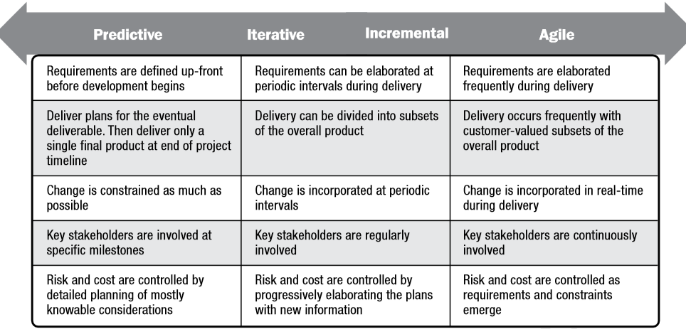
Various Method of Conducting Project

Slide 4




3.1 Project Management Methodologies
In waterfall life cycle, the scope is defined at the beginning of the project
In agile life cycle the scope is developed progressively over many interations
Baselined
Ongoing
Predictive life cycles
Adaptive/Agile life cycles
The Scope is baselined and can only be changed through formal change control
Are intended to respond well to high amount/level of changes
The contribution of the sakeholders/sponsor it is before the baseline
Require continuos stakeholders/sponsor engagement
Requirements are collected, scope is defined, and WBS is created once during the planning phase
The processes of Collecting Requirements, Defining Scope, and Creating WBS are repeated during agile projects
The Scope Baseline is used during the Monitoring and Controlling phase to prevent ‘scope creep’
This processes are performed since the beginning and updated as needed using the integrated change control process
The process of Validating Scope is performed at the end of each deliverable phase
The process of Validating and Controlling Scope are repeated for each interaction

Slide 5
During the Project Scope Management the stakeholders’ requirements are elicited, documented, and managed
Trends and Emerging Practices
Facilitate the implementation of the final deliverable (product, service, or result)
Both business and project requirements must be meet
For a successfull result PM and business analyst must fully understand each others roles and responsibilities
Collaborative partnership between PM and business analysis professionals
Determine problems, business needs and recommend viable solutions

Slide 6
Agile Enviroments
Scope Management in Agile Enviroments
Spend less time defining scope early in the project
Spend more time defing the processes for ongoing discovery and refinement
May build and review prototypes and versions to refine requirements
May avoid the gap between the real requirements and the original requirements
Scope can be define and redefined during the project
The requirements in agile projects constitute the ‘backlog’
Scope may not be understood at the beginning of the project

Slide 7
Contrast and compare the various project lifecycles (traditional waterfall, iterative and hybrid) and determine what type of projects would be applicable to each.

Slide 8
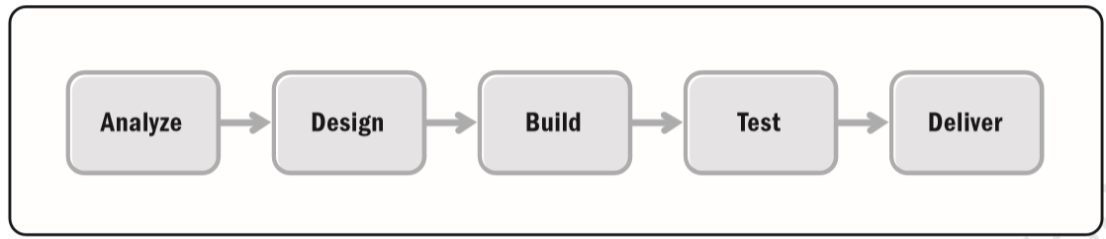
Predictive Life Cycle

Slide 9
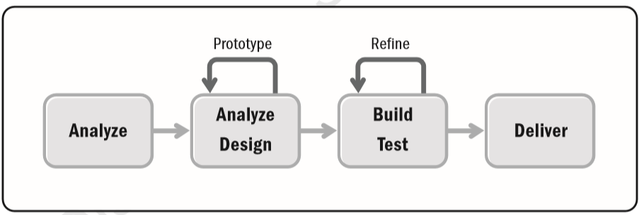
Iterative Life Cycle

Slide 10
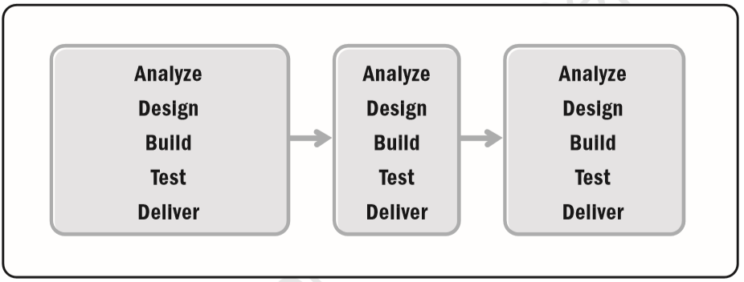
Incremental Life Cycle

Slide 11
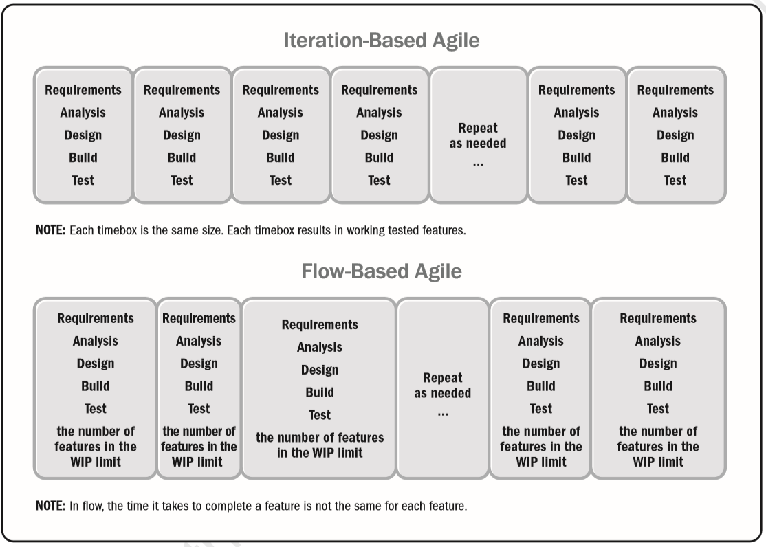
Agile Life Cycle

Slide 12
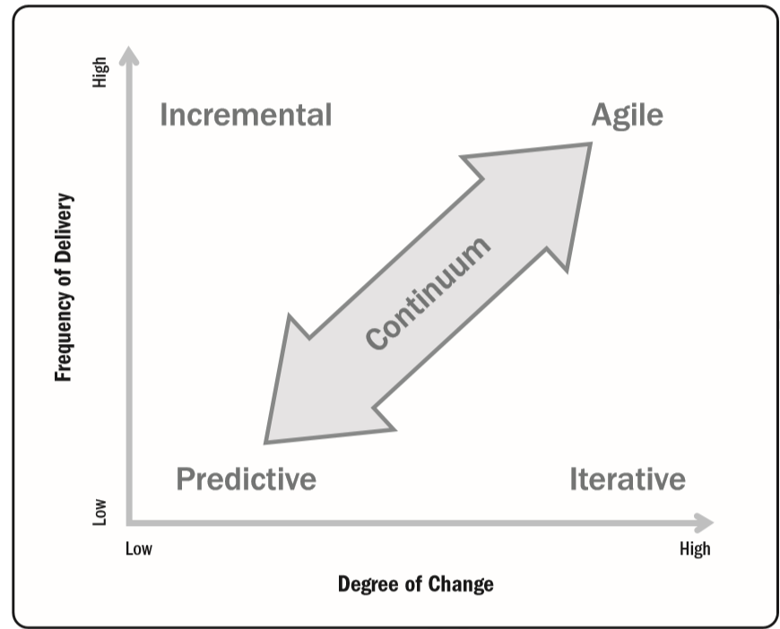
Hybrid: The Continuum of Project Life Cycle

Slide 13

Agile Vs Waterfall
Agile
Agile Methodology is a project management technique in which the project team handles the project by splitting it into multiple steps.
It requires continual communication with stakeholders and continuous development and iteration at a certain stage.
Waterfall
Waterfall methodology is a type of approach that disintegrates project activities into hierarchical linear sequences.
In this approach, following steps are based on the deliverables of the previous stage and conform to the specification of the activities.

Slide 14
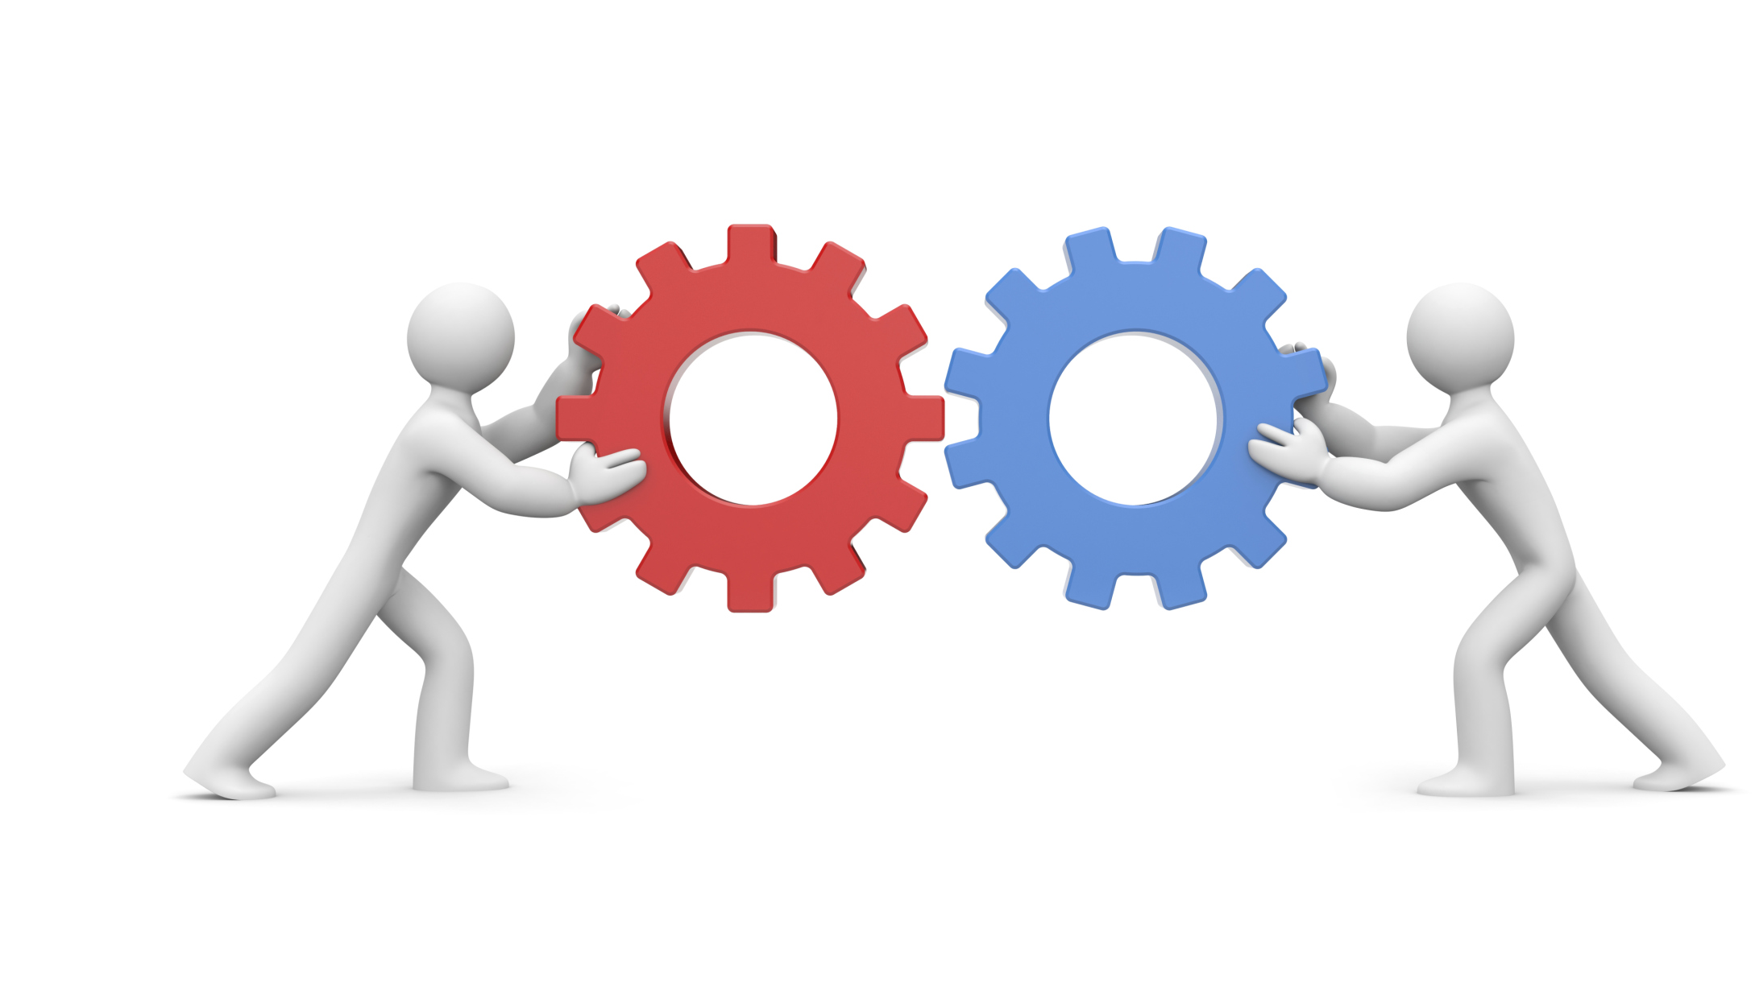
Similarities
They have common aims, which are to deliver high-quality tech applications and to keep consumers pleased and productive.
They carry out the same tasks, including the selection, design , production, testing and deployment of requirements.
The framework of the project includes planning, getting the project to life and tracking the success of the two approaches of the project.

Slide 15
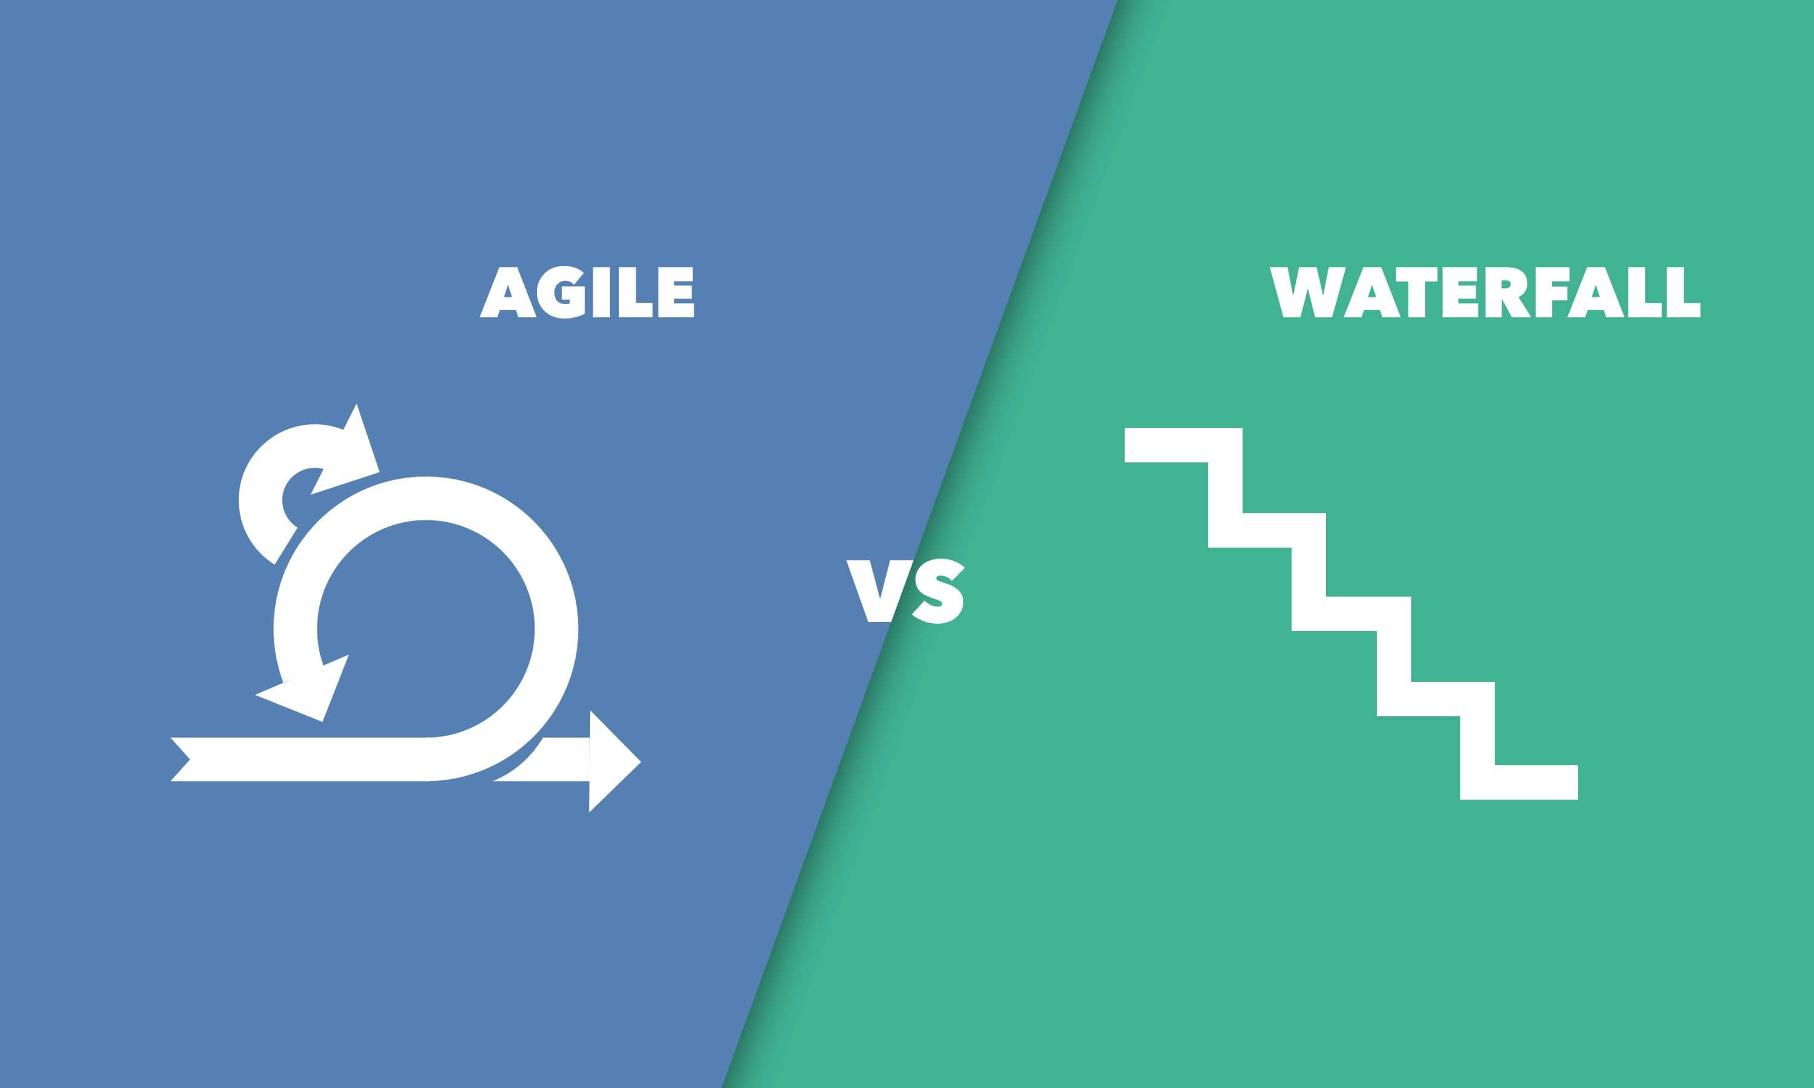
Difference
Waterfall | Agile
Project planning is done at the starting of the project and no change is permitted later. | Planning is done during sprint planning and is not given the most priority. Modifications are allowed except during an active sprint
Project progress is monitored as per the project plan. | Development gets conformed in each sprint
Only PM communicates and performs progress review meetings weekly or monthly. | Communication is often, face to face and clients stay engaged throughout the project
Roles cannot be changed once allotted to the team members | Roles can be switched
Documentation is stressed | There is a need to file requirements, build designs and write test plans to promote working software delivery

Slide 16
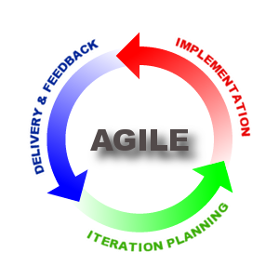
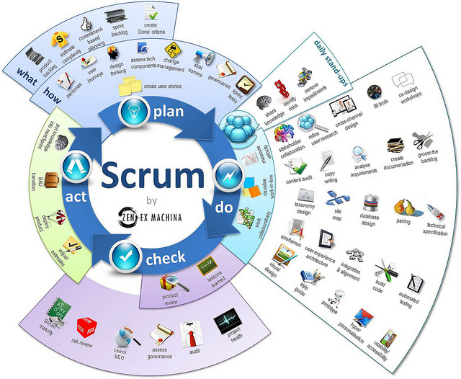
Agile | Scrum
Agile is a development methodology based on iterative and incremental approach. | Scrum is one of the implementations of agile methodology. In which incremental builds are delivered to the customers in every two to three weeks time.
In the Agile process, the leadership plays a vital role. | Scrum fosters a self-organizing, cross- functional team.
Project head takes care of all the tasks in the agile method. | There is no team leader, so the entire team addresses the issues or problems.
The Agile method encourages feedback during the process from the end user. In this way, the end product will be more useful. | Daily sprint meeting is conducted to review and feedback to decide future progress of the project.
In this method, each step of development like requirements, analysis, design, are continually monitored during the lifecycle. | A demonstration of the functionality is provided at the end of every sprint. So that regular feedback can be taken before next sprint.
The agile method needs frequent delivery to the end user for their feedback. | In the scrum, after each sprint, a build is delivered to the client for their feedback.
This Photo by Unknown Author is licensed under CC BY-SA-NC

Slide 17
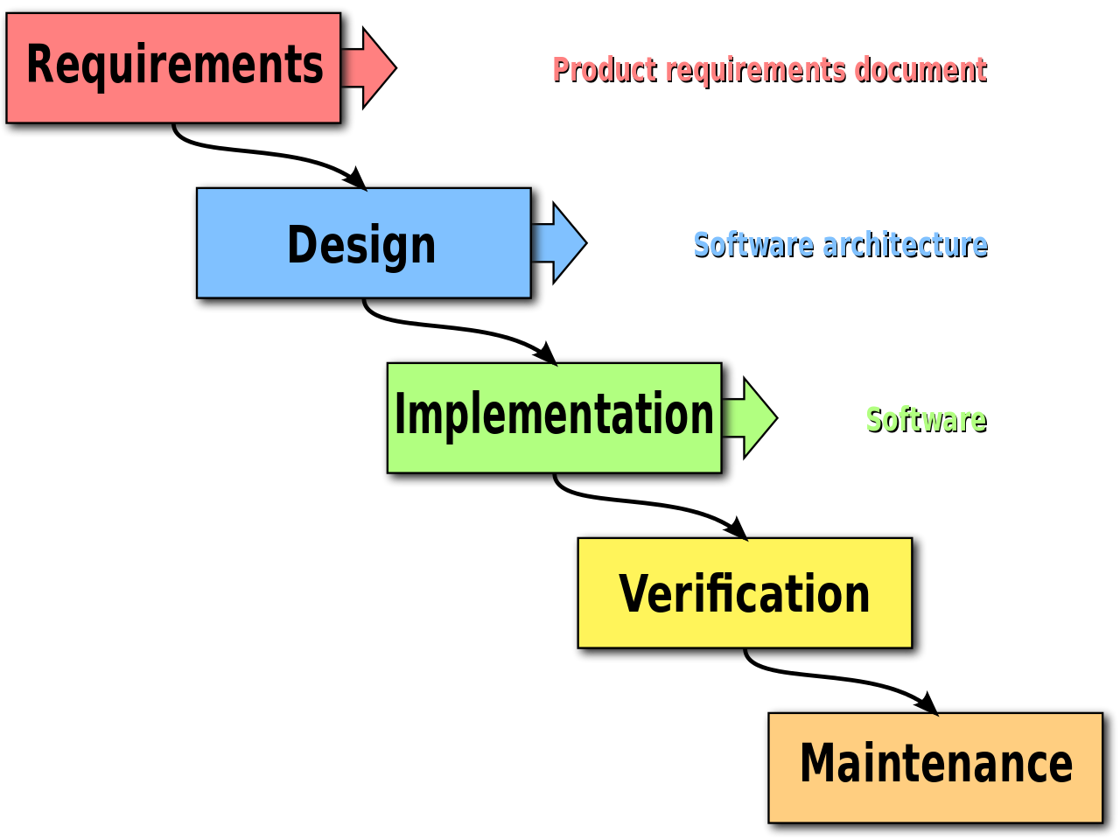
WATERFALL Overview
A linear- sequential project management approach
It’s a thorough, structured methodology
Requirements are gathered at the beginning of the project
Each phase must be completed fully before the next phase can begin
Preferred tool is Gantt chart
Development of Department Of Defense (DOD), military and aircraft programs followed Waterfall model.

Slide 18
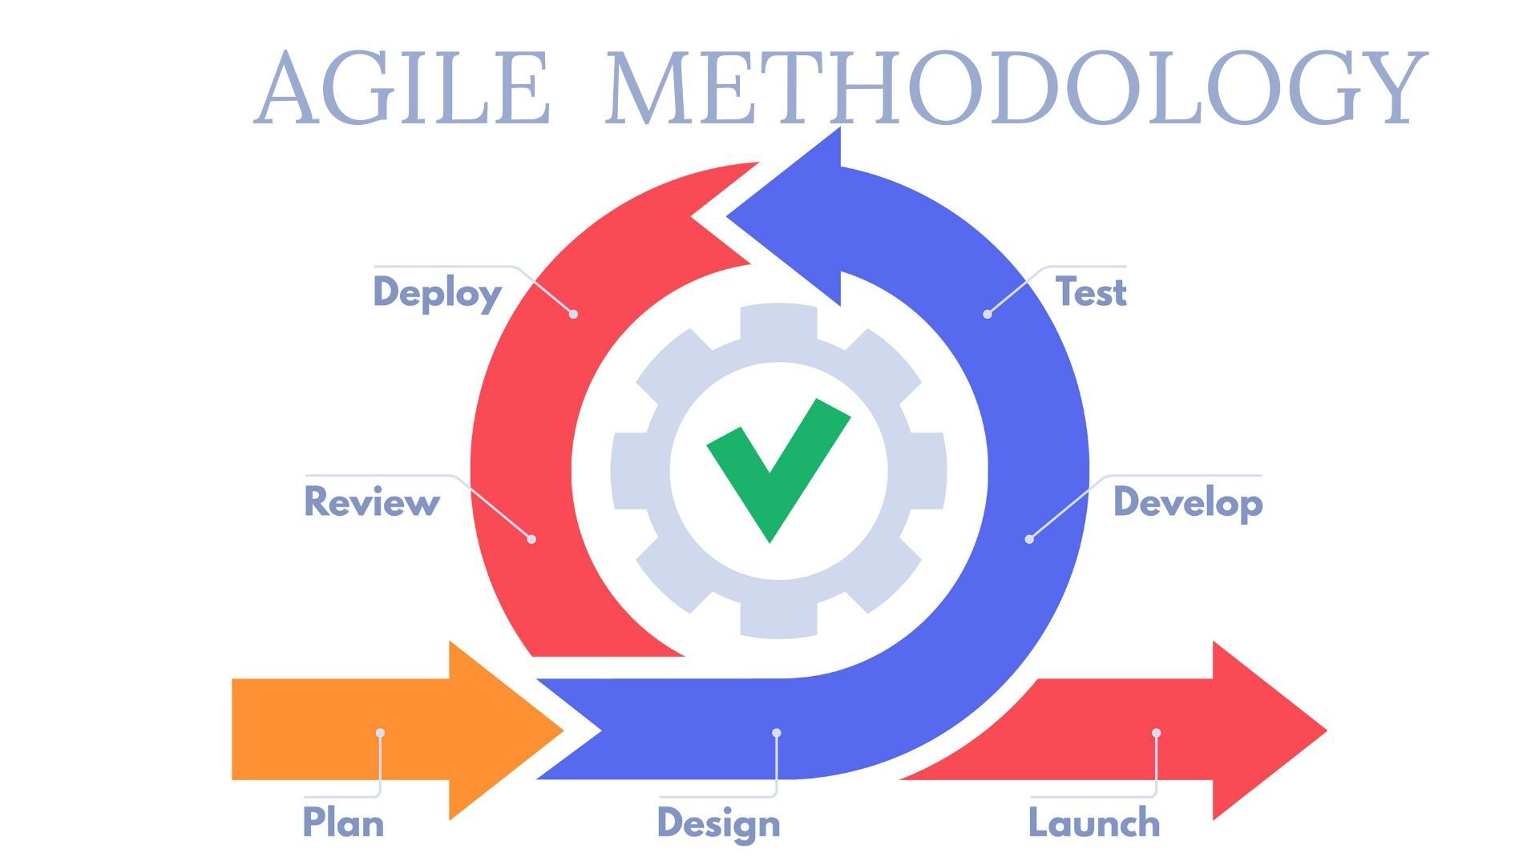
AGILE Overview
Agile practice in developing solutions through collaborative efforts of team.
It value the individual and interactions over process and tools.
Allow team to work on software over comprehensive documentation.
Agile allow to respond to change over following a plan.
It is efficient and focus on quality.

Slide 19
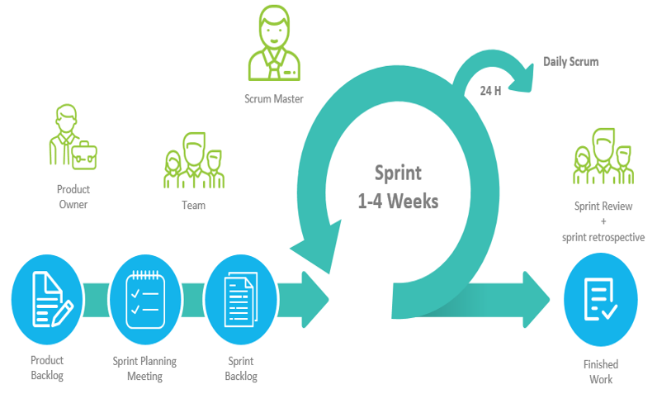
Agile - Scrum Process
8
Notes:
Marian

Slide 20
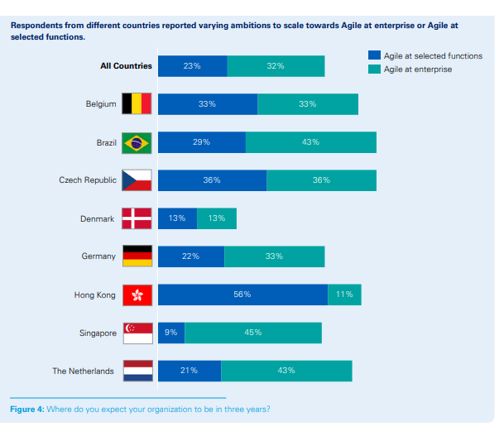
Agile and Scrum at Country Level

Slide 21

Scrum in Different Fields
Operations or product development (45%)
Research and development (39%).
Departments seeing a rise in scrum include:
- Sales and marketing (31%).
- Finance/accounting (20%).
- Human resources (20%).
Google, Yahoo, Microsoft, Facebook, Adobe, Nokia, Siemens, BBC, CNN, General Electric, Bank of America, Novell……..

Slide 22
Agile Adoption Statistics 2020
71% of companies are adopting Agile.
Agile adoption has helped 98% of companies.
60% of companies experience growth in profits after adopting an Agile approach.
80% of federal IT projects adopt Agile.
The Agile failure rate is 8%.
Research &Development (83 percent)
Production and operations (82 percent)
Customer service and support (79 percent)
Marketing and communications (79 percent)
Sales (78 percent)
HR, finance, and administration (78 percent)
Well-known companies that use Agile include Apple, IBM, Microsoft and Procter & Gamble.
Best Example
Agile Delivery at British Telecom
Agile framework used: Scrum + XP; 90-day delivery cycles
Year started: 2004

Slide 23
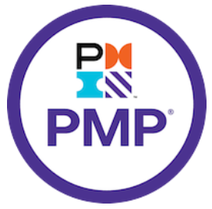
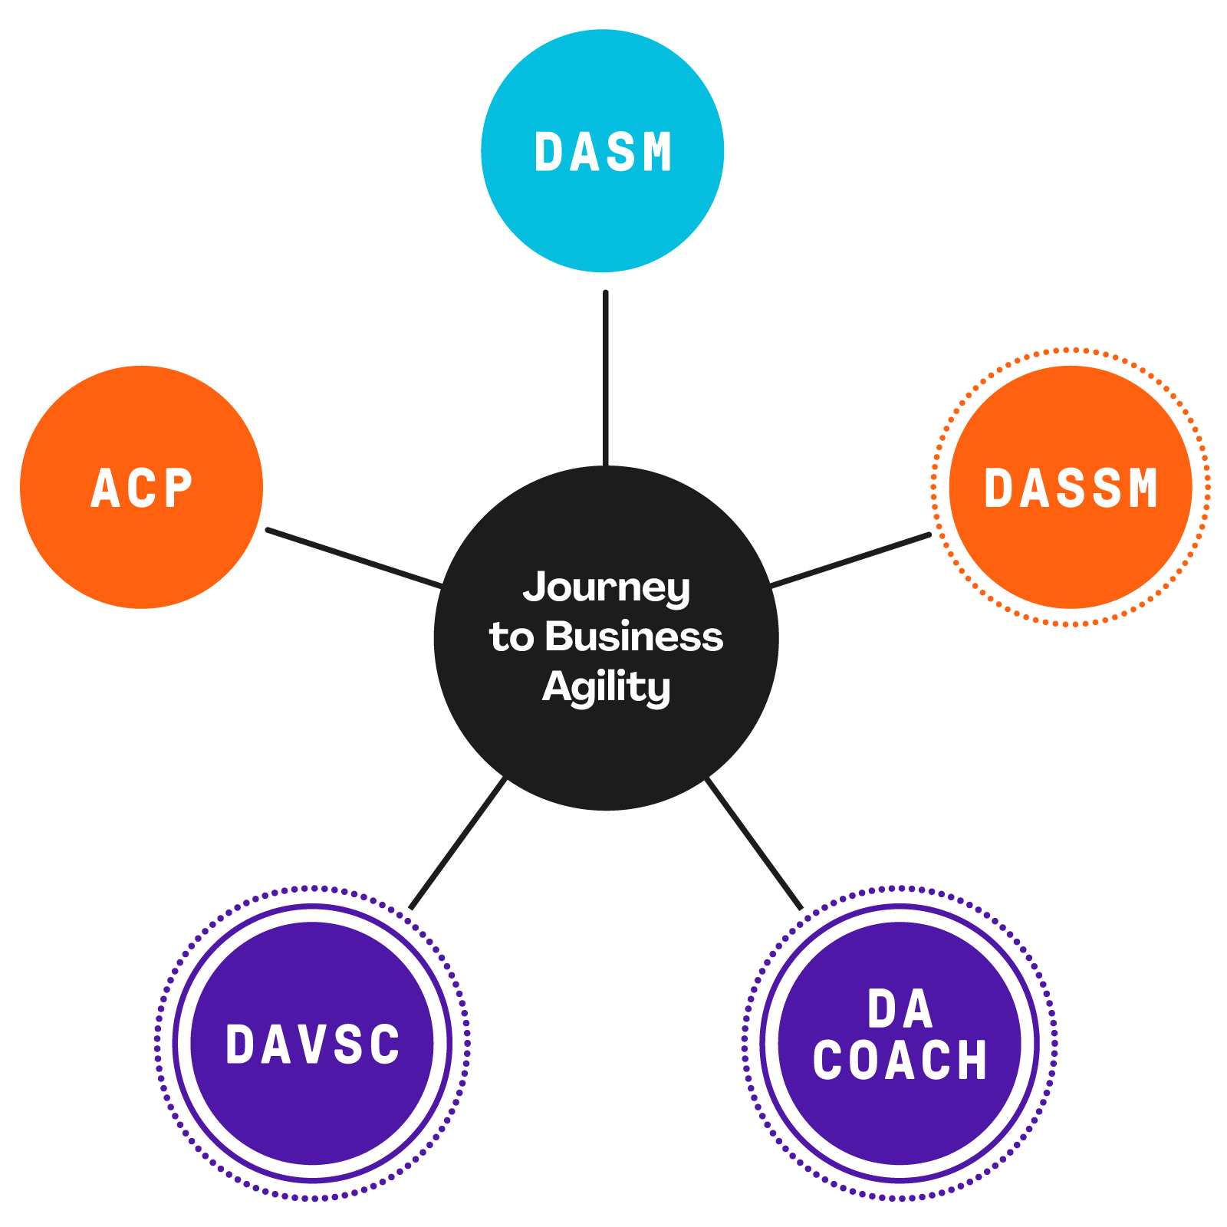
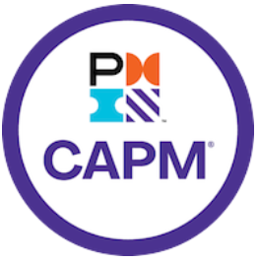

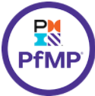


PMI - Project Management Institute
AGILE
WATERFALL
Disciplined Agile Scrum Master
Project Management Professional
Disciplined Agile Senior Scrum Master
PMI Agile Certified Practitioner
Certified Associate in Project Management
Portfolio Management Professional
Program Management Professional
PMI Risk Management Professional
Disciplined Agile Value Stream Consultant
Disciplined Agile Coach
PMI Scheduling Professional

Slide 24
Managing Complexity in the Face of Uncertainty
Risk Management: Complexity and Uncertainty in the Project Management Landscape

Slide 25
What risk management is
Anticipating what could go wrong, or right, and managing the outcome.
Developing strategies to eliminate and/or reduce two things: for negative risks:
The probability that risk events will occur and /or
The impact of the events if they occur
Implementing strategies and monitoring the outcomes on the project.
Notes:
Emphasize that risks can be positive or negative, and it is important to have a balance of each so the opportunities can pay for the threats.

Slide 26
Project Risk Management
Processes concerned with:
Conducting risk management planning, identification analysis, responses, and monitoring and control on a project
Objectives
To increase the probability and impact of positive events
To decrease the possibility and impact of negative events

Slide 27
Sources of Project Risk
Changes in scope/requirements
Design errors, omissions, misunderstandings
Poorly defined or poorly understood responsibilities
Poor estimates
Staff inadequacies - insufficient numbers, inadequately trained/skilled and/or equipped workers

Slide 28
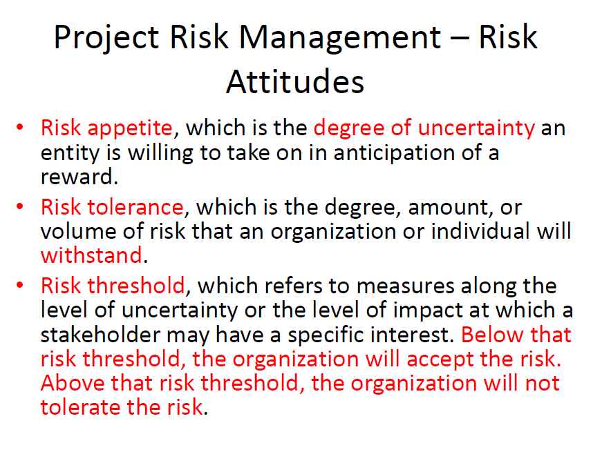

Slide 29
Risk Identification Category Checklists
Project Scope**
Project Schedule**
Materials *
Facility & Equipment*
Resources*
Organizational
Personal**
People & Interpersonal**
External Influences
Four main categories
*Technical, quality or performance category
**Project management category
Organizational
External

Slide 30
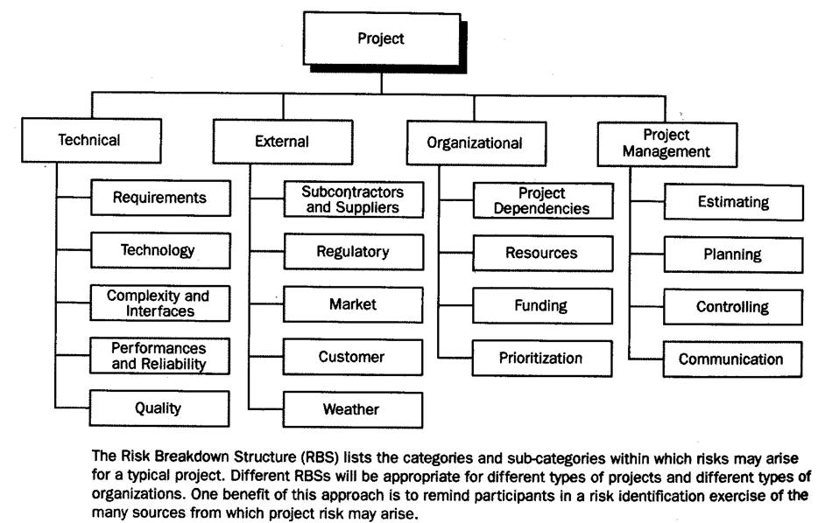
Risk Breakdown Structure (RBS)

Slide 31
Complexity and Uncertainty …
Understanding the complexity/uncertainty domain of projects
Requirements
Flexibility
Adaptability
Risk vs. the Complexity/Uncertainty Domain
Team Cohesiveness vs. the Complexity/Uncertainty Domain
Communications vs. the Complexity/Uncertainty Domain
Client Involvement vs. the Complexity/Uncertainty Domain
Specification vs. the Complexity/Uncertainty Domain
Change vs. the Complexity/Uncertainty Domain
Business Value vs. the Complexity/Uncertainty Domain
Notes:
Explain how each of these contributes to the growing importance of project management in the business world.

Slide 32
Complexity and Uncertainty …
Contemporary Project Landscape
SOLUTION
Clear
Not Clear
Not Clear
GOAL
Clear

Slide 33
Complexity and Uncertainty …
Non-Value-Added Work
Non-value-added work involves the consumption of resources (usually people or time) on activities that do not add business value to the final product or process.

Slide 34
Complexity and Uncertainty …
The Complexity/Uncertainty Domain
Not
Clear
Q4
Q3
Complexity
Goal
Uncertainty
Clear
Q1
Q2
Clear
Not
Clear
Requirements
Flexibility
Adaptability
Solution

Slide 35
Complexity and Uncertainty …
Risk
Not
Clear
Q4
Q3
Goal
Risk
Clear
Q1
Q2
Clear
Not
Clear
Solution

Slide 36
Complexity and Uncertainty …
Team Cohesiveness
Not
Clear
Q4
Q3
Goal
Cohesiveness
Team
Clear
Q1
Q2
Clear
Not
Clear
Solution

Slide 37
Complexity and Uncertainty …
Communications
Not
Clear
Q4
Q3
Goal
Communications
Clear
Q1
Q2
Clear
Not
Clear
Solution

Slide 38
Complexity and Uncertainty …
Client Involvement
Not
Clear
Q4
Q3
Goal
Client
Involvement
Clear
Q1
Q2
Clear
Not
Clear
Solution
Client comfort zone
Ownership by the client
Client sign-off

Slide 39
Complexity and Uncertainty …
Specification
Not
Clear
Q4
Q3
Goal
Specification
Clear
Q1
Q2
Clear
Not
Clear
Solution

Slide 40
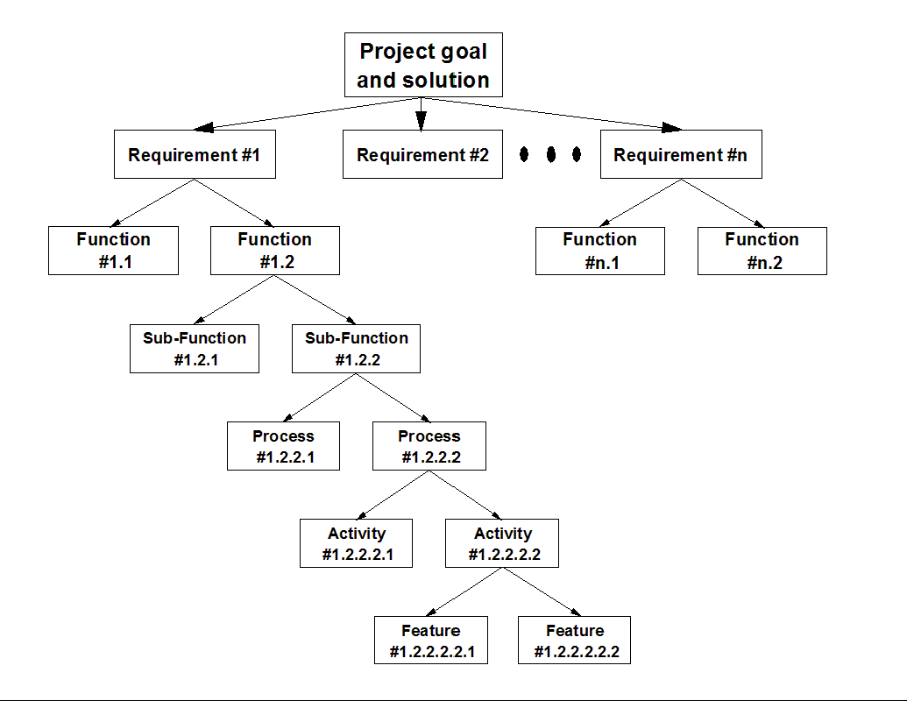

Complexity and Uncertainty …
The Requirements Breakdown Structure
Figure
09-02

Slide 41
Complexity and Uncertainty …
Change
Not
Clear
Q4
Q3
Goal
Change
Clear
Q1
Q2
Clear
Not
Clear
Solution

Slide 42
Complexity and Uncertainty …
Business Value
Not
Clear
Q4
Q3
Goal
Business Value
Clear
Q1
Q2
Clear
Not
Clear
Solution

Slide 43
Reference
Mohamed Tawfik (Feb 12,2013) , IEEE Presentation and comparison, Retrieved from- https://www.slideshare.net/MTawfik86/ieee-presentation-16492015
James Freeman ( May 23, 2020), Agile v/s Waterfall, Retrieved from- https://www.edrawsoft.com/agile-vs-waterfall.html?gclid=CjwKCAiAv4n9BRA9EiwA30WNDx6TqrpDOIC1zDZbJ4e08R1EAObK-qBS5bK1yWYBVtNVT_MDSuGPoxoCreIQAvD_BwE
Raj Vardhman (August 21, 2020) , Agile Adoption Statistics , Retrieved from- https://goremotely.net/blog/agile-adoption/
The State of Scrum Report 2017 Edition, Retrieved from- https://www.scrumalliance.org/ScrumRedesignDEVSite/media/ScrumAllianceMedia/Files%20and%20PDFs/State%20of%20Scrum/State0fScrum_2016_FINAL.pdf
Guru 99, (November 1, 2020), Agile v/s Scrum, Retrieved from- https://www.guru99.com/agile-vs-scrum.html#:~:text=Agile%20is%20a%20continuous%20iteration,the%20software%20after%20each%20sprint.
Alesia Krush (January 13, 2018), Success Stories of Agile, Retrieved from- https://www.objectstyle.com/agile/scaled-agile-success-story-lessons

